Slide 1
Design of Restaurant Billing System (E Bill Resto) by Applying Synchronization of Data Billing in Branch Companies to Main Companies Based on Rest API
PRESENTED BY :
B.SAYA REDDY (U19CS090) A.RAMGOPAL REDDY (U19CS083)

Slide 2

CONTENTS
Abstract
Introduction
Literature survey
Existing System and Disadvantages
Proposed System and Advantages
System Requirements
System Design
Testing
Further Enhancement
Conclusion

Slide 3
ABSTRACT
Culinary business is a business opportunity that is most in-demand, E Bill Resto is a restaurant billing system that was developed by involving several selling places/restaurants with the name of a brand that is connected to the parent company by a database server. With an integrated system, all revenue from restaurant sales can be monitored in Realtime.
The system design is made by implementing the RESTFUL API architecture with security access tokens. The Master Application as a provider of Embedded Data Service Web resources on 3 Restaurant Information Systems, It does the synchronization of 3 Web Service Clients, Data From the Master-Slave Side was obtained by testing 3 data sampling, where both applications are tested QoS with 3 new data samples, from the INDOSAT Internet Provider which showed an average test result of Throughput of 170.3 bps, Packet Loss of 18.851% and Delay of 78.4 ms.

Slide 4
INTRODUCTION
With the increasing population in the current era of globalization, the potential for data growth is also increasing.
. With the growth of these data, the business world is formed, information technology is also demanded to develop and innovate so that it can run following the progress of the business world including data exchange and management of information on an increasingly complex Client-Server.
The problem that occurs is the data on Information Systems in a main company and clients for business branches, especially for restaurant applications.
So from the description, to overcome data exchange, management and security in each Web Content of Information System, then design a web service database storage using the RESTful API architecture.

Slide 5
INTRODUCTION
REST (Representational State Transfer):
REST (Representational State Transfer) is a web-based communication architecture standard that is often applied in developing website services.
Generally, use HTTP (Hypertext Transfer Protocol) is a protocol for data communication. In the REST architecture, the REST client provides resources (resources/data) and the REST server accesses and displays these resources for future use.
These resources are represented in text format, JSON or XML. There are some HTTP Methods on REST Webservice such as GET, PUT, POST, DELETE, OPTIONS.

Slide 6
LITERATURE SURVEY
Implementation of Database Synchronization Technique between Client and Server.
Middleware based Data Replication Providing Snapshot Isolation.
A Study on a JWT-Based User Authentication and API Assessment Scheme Using IMEI in a Smart Home Environment.
LDAKM-EIOT: Lightweight Device Authentication and Key Management Mechanism for Edge-Based IoT Deployment
Smart Home Design with XBEEWi-Fi and Android-Based Graphical User Interface

Slide 7
EXISTING SYSTEM
In the existing applications in the client billing are still stored only in each local database, making it difficult to process and develop into the Web Content of Information System integrated so that information management, data exchange until making management of two databases is still very limited.
In addition to the limited management of information, the security of the data storage is also mandatory.

Slide 8
LIMITATIONS OF EXISTING SYSTEM
We only use a tiny bit of the HTTP protocol's methods – namely GET and POST.
HTTP is a protocol used for communication, usually used to communicate with internet resources or any application with a web browser client.
GET: /string/someotherstring It is idempotent and should ideally return the same results every time a call is made.

Slide 9
PROPOSED SYSTEM
In the Proposed the management and security in each Web Content of Information System, then design a web service database storage using the RESTful API architecture.
The design and integrated database system is Data Synchronization of the main company and client information system in the form of a POS (Point of Sales) application of 3 Bill Resto Information Systems as a Master Database Web Service.
Second, data exchange is secured using the JSON Web Token (JWT) security access HS256 algorithm with a static data retrieval method. Data exchange mechanism that occurs is, where in general the RESTful API architecture.
There are two Server and Client applications to serve embedded database data exchange in 3 Client Information Systems as Servers and 1 Information System as Server Systems for a Main Company

Slide 10
SYSTEM REQUIREMENTS
HARDWARE REQUIREMENTS:
System : Intel core i3.
Hard Disk : 1 TB.
Monitor : 15’’ LED.
Input Devices : Keyboard, Mouse.
Ram : 8 GB.

Slide 11
SYSTEM REQUIREMENTS
SOFTWARE REQUIREMENTS:
Operating System : Windows 10.
Coding Language : Python
Tools : PyCharm,Visual Studio
Database : SQLite

Slide 12
SYSTEM DESIGN
ARCHITECTURE
Architecture helps in design, development, implementation, and maintenance of a database.
A web application architecture has to not only deal with efficiency, but also with reliability, scalability, security, and robustness.

Slide 13
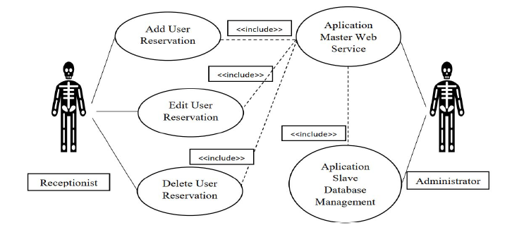
SYSTEM DESIGN
System Architecture

Slide 14
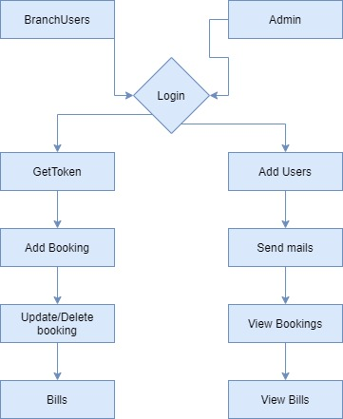
DATA FLOW DIAGRAM

Slide 15
USECASE DIAGRAM

Slide 16
CLASS DIAGRAM

Slide 17
MODULES
Modules used in the Resturant billing system are
Branch Users
Admins
Jwt Token
REST (Representational State Transfer)

Slide 18
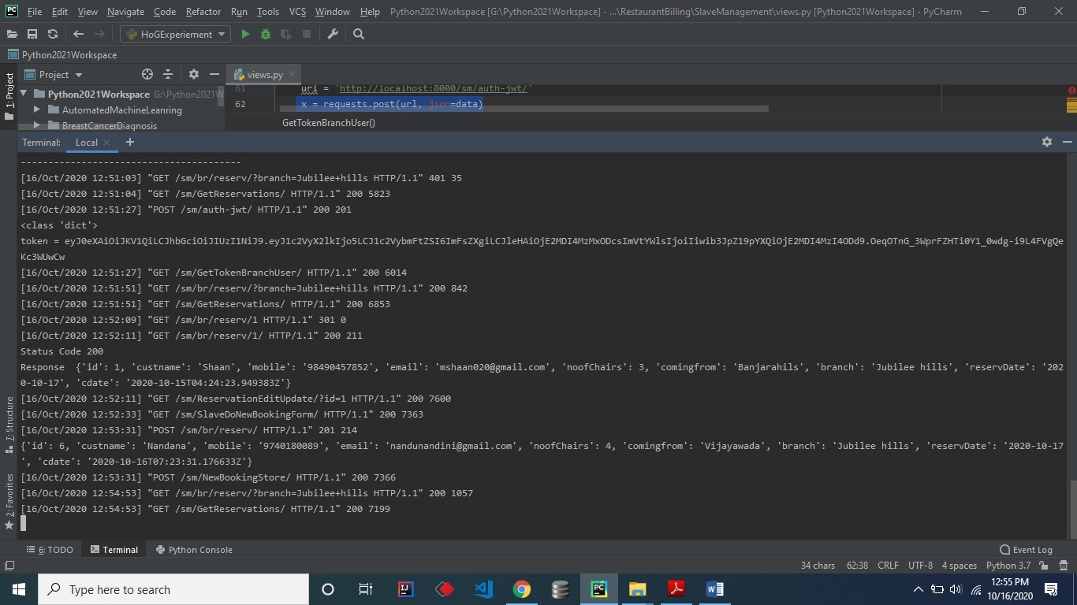
SCREEN SHOTS

Slide 19
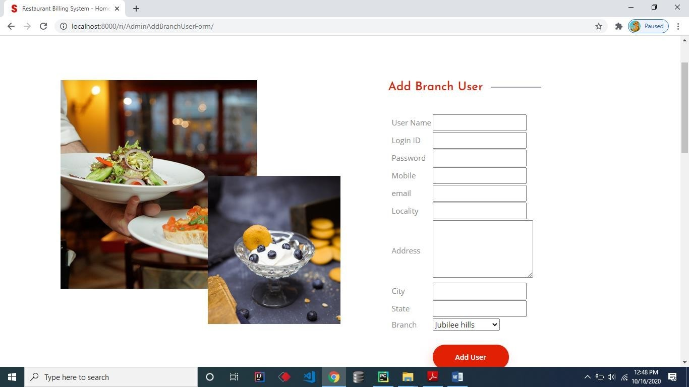

Slide 20
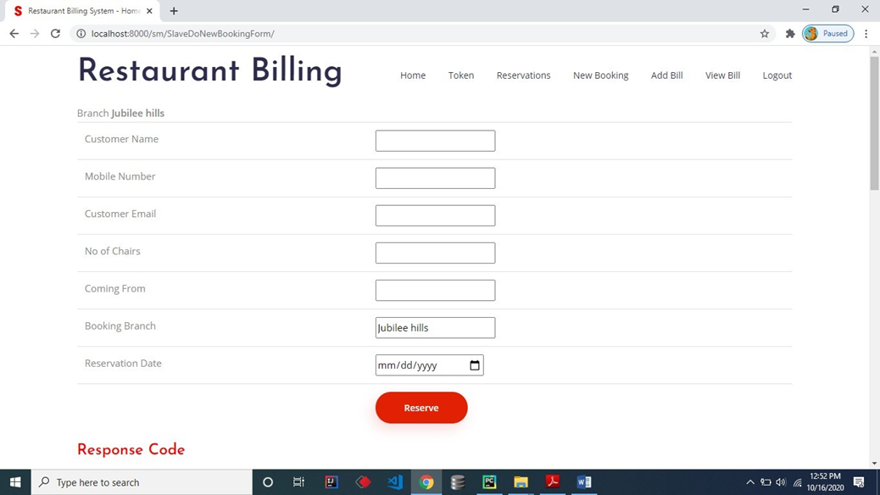

Slide 21
FURTHER ENHANCEMENT
OAuth2 on the other hand is not a protocol, it’s a delegated authorization framework. think very detailed guideline, for letting users and applications authorize specific permissions to other applications in both private and public settings. OpenID Connect which sits on top of OAUTH2 gives you Authentication and Authorization.it details how multiple different roles, users in your system, server-side apps like an API, and clients such as websites or native mobile apps, can authenticate with each other.

Slide 22
CONCLUSION
Based on the System Implementation, functional testing, error handling testing and QoS (Quality of Service) test results in the previous chapter, it can be concluded that the cloud master web service and slave management database applications are running as expected.
Then it can be concluded that the test based on TIPHON Throughput and Delay (latency) from INDOSAT 4g and TELKOM Internet signal providers shows the category of "Very Good" while the Packet Loss test is obtained by the "Bad" category.

Slide 23
REFERENCES
Putra, R. E., Izzati, B. M., and F. Dewi, “Point of Sale (POS) Performance Optimization with Database Synchronization Implementation Using Middleware”. Informatika Mulawarman : Jurnal Ilmiah Ilmu Komputer, 12(2), 123, 2017.
Malhotra, N., & Anjali, C., “Implementation of Database Synchronization Technique between Client and Server”. International Journal of Engineering Science and Innovative Technology (IJESIT), 3(4), 460–465, 2014.
Lin, Y., Kemme, B., Patiño-Martínez, M., & Jiménez-Peris, R., “Middleware based Data Replication Providing Snapshot Isolation”. In Proceedings of the 2005 ACM SIGMOD International Conference on Management of Data - SIGMOD ’05 (419), 2005.

